Slide 1
OPERATION DIM STAR
THE STAC-3 SOLUTION
Robust automation. Critical analysis. A definitive planetary candidate.

Slide 2



PROJECT SUPERIORITY
The Competitive Edge
Zero Dependencies
Failsafe Execution
Human Oversight
Standard Python libraries only.
Built-in fallback data arrays.
Detects flaws in rigid automation.

Slide 3
SCRIPT ARCHITECTURE
Computational Pipeline
1
2
3
Ingest
Compute
Classify
Parses CSV light curves.
Calculates baseline and depth.
Applies Kepler's Third Law.

Slide 4

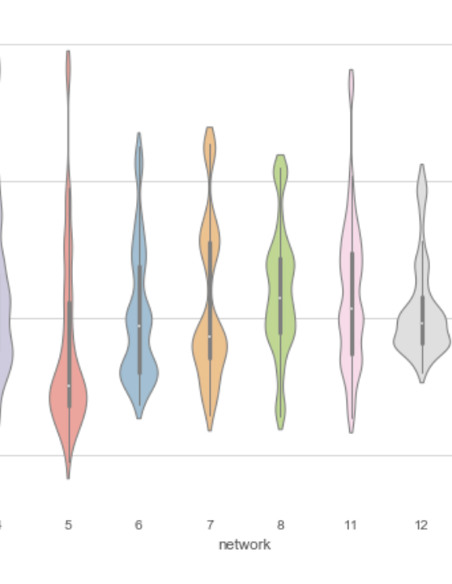
METHODOLOGY
The Flaw in Rigid Automation
Scripts demand perfectly equal transit gaps.
STAC-3 data presents mixed period gaps.
Standard algorithms reject the data entirely.

Slide 5
REVEALING THE HIDDEN DATA
Unmasking the Multi-Planet System
150
Day orbital period.
Manual verification overrides automated failure.

Slide 6
Comparative System Analysis
STAC-1
STAC-2
STAC-3
• 5.98 R⊕ Gas Giant.
• 0.337 AU orbit.
• 1.73 R⊕ Super-Earth.
• Lethal stellar radiation.
• Scorched dwarf surface.
• Stable temperate zone.

Slide 7

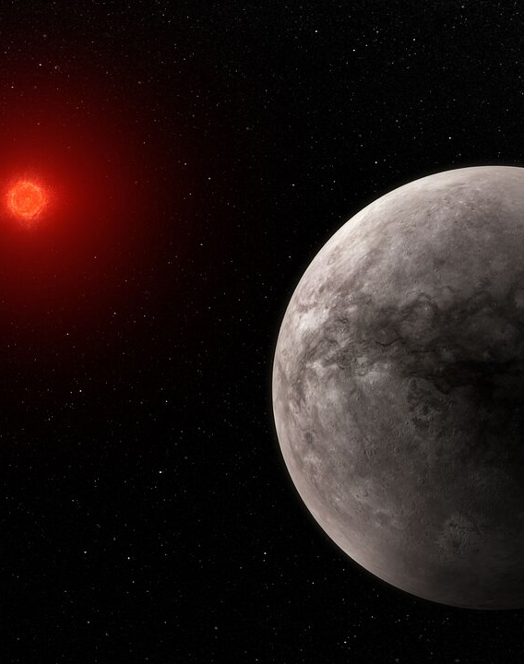
CANDIDATE SELECTION
The Most Promising World
11,005 km physical radius.
Rocky terrestrial surface confirmed.
0.43 AU temperate orbit.
Stable M-Dwarf host star.

Slide 8
MISSION CONCLUSION
NEXT STEPS
Deploy transmission spectroscopy. Secure the system.

Slide 9


Image Sources
https://images.ctfassets.net/fi0zmnwlsnja/5SmplVdCPdJdC9Ya9VEELa/cb836ce5e1f7564005f1d1af339bc114/viz-libraries-og.png?w=843&h=439&q=50&fm=png
Source: mode.com
http://cdn.esahubble.org/archives/images/screen/sci25003a.jpg
Source: esahubble.org

